Slide 1
Jupyter Notebook: Improving Workflow for Social Science Research
Scott Oatley

Slide 2

Agenda
Topic one: Presentation on Workflow/Open Science + Group Discussion
Topic two: Installing and Setting up Jupyter Notebook
Topic three: Teaching the Basics of Jupyter Notebook
Topic four: Advanced Jupyter Notebook + Extensions
Notes:
Note on Lunch: 1pm – same room etc
Each block will have a 10 mins coffee break
Should finish by 4:30pm

Slide 3
Topic one
Presentation on Workflow/Open Science + Group Discussion

Slide 4

Introduction
Workflow
Open Science
Notes:
What is workflow? Most of us don’t have one – I certainly didn’t. I had .do files all over the place, my files were named weird things, I designed all my graphs in the editor overusing code, I would never have been able to replicate my PhD.
What is open-science? Practices that allow a free flow of information and replicability and reproducibility in science. This is enabled through a good and healthy workflow. (anecdote, some research on the topic of people given their code out found about 1/10 would actually share code)

Slide 5
Workflow
Have you ever lost a file?
Have you ever wondered if you have deleted a file?
Have you had difficulty identifying which file is the correct one? (e.g. 20102023_finalchapter_thesis_part_one_for_real_this_time)?
Have you re-run a statistical analysis and struggled to replicate a previous result?
Notes:
Breaking Workflow (Reference manager, .do file, dataset, word document etc…)

Slide 6
Four Pillars
Accuracy
Programming Efficiency
Transparency
Reproducibility
Notes:
Accuracy relates to minimising information loss and errors in both analyses and outputs.
Programming Efficiency relates to maximising the features offered by software, and when possible automating (or semi-automating) actions. S
Transparency is central to good social science data analysis practices. When work is appropriately transparent questions of the ‘who, what, where, when and why’ variety are easily answered.
Reproducibility is a cornerstone of good social science. In essence, work can be reproduced when the same results are produced every time, despite who undertakes the analysis, or where it is 6 undertaken.
The last two of these pillars are fundamental in Jupyter. Accuracy is improved through Jupyter, and Programming efficiency is enabled through advanced extensions.

Slide 7
Workflow
How many times have you been in a supervision and have been asked ‘’How was that variable asked in the survey?’’
Notes:
Jupyter Notebook provides the ability to include management of variables. The notebook environment allows you to not only explore variables within a given software – but also include images/videos/web links to data documentation alongside your live code. This makes those supervisor or ‘’VIVA’’ questions so much easier to answer.

Slide 8
Workflow
Syntax Files
Notes:
We all know what a .do file is. We also know how annoying they can be. Long form comments just don’t work properly in a .do file. They are bulky, they get in the way, and often times we cut them out or simplify them to such a degree that they become pointless. With Jupyter your syntax works alongside your live code which compliments your running commentary – see Vernon and Roxanne's example of this.

Slide 9
For another explanation, see Vernon…
https://www.youtube.com/watch?v=Os3s1jwLAEI&t=627s

Slide 10
Workflow + Open Science issues?
Notes:
Does anyone else have any experiences to share regarding workflow or open-science issues?
Share the example of imputing dead people only after searching through online appendix materials.

Slide 11
Topic Two
Installing and Setting up Jupyter Notebook

Slide 12
Installation
Download Anaconda
Also download PIP
Jupyter Notebook
Notes:
Anaconda is the easiest way to install Jupyter – but we won’t use it. We want Anaconda for the ‘Anaconda Prompt’ (If on MacOS you just use the terminal after downloading Anaconda. ALL CODE WILL BE THROUGH ANACONDA PROMPT.
For pip route we need to download python – check the version to see if you have it, if not download (if on windows simply type python and it will take you to the windows store) otherwise follow link in substack to be taken to python official webpage and download. After this is down check back with same code to make sure it is downloaded.
After this install pip, then jupyter.

Slide 13
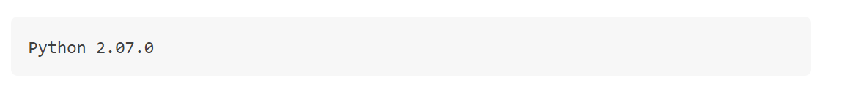
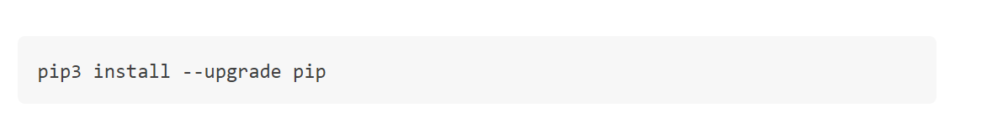
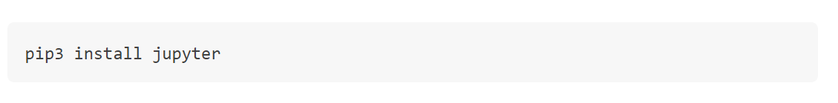
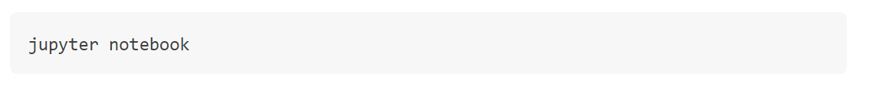

Slide 14
Stata Setup
Install stata_setup via pip
Open up Jupyter Notebook and in the first cell of a new Notebook type:
‘’import stata_setup”
Followed by:
stata_setup.config(“directory_folder”, “Stata_version”)
Notes:
If you can’t find your stata directory open stata and display c(sysdir_stata)

Slide 15
Topic three
Teaching the Basics of Jupyter Notebook

Slide 16
Topic four
Advanced Jupyter Notebook + Extensions

Slide 17
Q+A?

Slide 18



Summary
Discussed workflow and open science practices
Installed Jupyter Notebook on machines
Setup Stata in Jupyter Notebook
Gotten to know the basics of Jupyter
Started on our ‘advanced journey’

Slide 19




Thank you
Scott Oatley
s2265605@ed.ac.uk
https://scott0atley.github.io/Scott0atley/

